Slide 1
Books
Java Programming
Prof. (Dr.) D. R. Gangodkar
Dean International Affairs and Prof. Dept. of CSE
Java The Complete Reference
Herbert Schildt, McGraw Hill, eighth edition
Programming with Java , A Primer
E. Balaguruswamy, McGraw Hill, fourth edition
Thinking in Java,
Bruce Eckel, Pearson

Slide 2

Lecture 1: Overview of Java

Slide 3
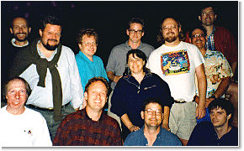
History
James Gosling, Mike Sheridan, and Patrick Naughton initiated the Java language project in June 1991
Led by James Gosling Sun Microsystems engineers decided to develop a language for consumer devices (cable boxes, etc.) called Green Project. Initial name of lang. was Oak.

Slide 4
History
They wanted the language to be hardware independent since different manufacturers would use different macro/micro processors.
This called for a concept known as Virtual Machine
In 1995 the language was renamed as Java
Though the acceptability for consumer devices was not encouraging, Internet Era led to development of HotJava (now discontinued) and later other browsers, Use of Applets, more secure and portable (now discontinued),
general-purpose object-oriented language, programming concepts are based on C/C++
Currently Owned by Oracle Corporation

Slide 5
Why Java*?
Java is the foundation for virtually every type of application and is the global standard for developing and delivering:
embedded and mobile applications
Games
Web-based content and enterprise software
From laptops to datacenters, game consoles to scientific supercomputers, cell phones to the Internet to Cloud and Big Data Analytics, Java is everywhere
Some statistics:
97% of Enterprise Desktops Run Java
89% of Desktops (or Computers) in the U.S. Run Java
9 Million Java Developers Worldwide
3 Billion Mobile Phones Run Java
100% of Blu-ray Disc Players Ship with Java
5 Billion Java Cards in Use
125 million TV devices run Java
* Source: https://www.java.com/en/about/ 01/04/2015

Slide 6
Java not only a language but is a Technology !
Java technology is both a programming language and a platform
The Java programming language is a high-level, object-oriented language.
programs are both compiled and interpreted
Compilation translates Java code into an intermediate code called Java bytecode.
Bytecode is in turn parsed and run (interpreted) by the Java Virtual Machine (JVM)
The Java platform is a software-only platform that can run on top of most hardware platforms
It consists of the JVM and the Java API — a large collection of ready-made components (classes) that ease application development and deployment
It is grouped into libraries — known as packages

Slide 7
Java not only a language but is a Technology !
The platform comes in following versions
Java Card: A technology that allows small Java-based applications to be run securely on smart cards and similar small-memory devices including IoT.
Java ME (Micro Edition): Specifies several different sets of libraries (known as profiles) for devices with limited storage, display, and power capacities. Often used to develop applications for mobile devices, PDAs, TV set-top boxes, and printers.
Java SE (Standard Edition): For general-purpose use on desktop PCs, servers and similar devices.
Java EE (Enterprise Edition): Java SE plus various APIs useful for multi-tier client–server enterprise and Web applications
etc...

Slide 8
Java Features (1)
Simple
fixes some clumsy features of C++
no pointers
automatic garbage collection
No pre-processor header files
rich pre-defined class library
Object oriented
focus on the data (objects) and methods manipulating the data
all functions (methods) are associated with objects
almost all datatypes are objects (files, strings, etc.)
potentially better code organization and reuse

Slide 9
Java Features (2)
Complied and Interpreted
java compiler generate byte-codes, not native machine code
the compiled byte-codes are platform-independent
java bytecodes are translated on the fly to machine readable instructions in runtime (Java Virtual Machine)
Good Performance
Performance of Java is impressive for an interpreted language
Makes use of JIT for speeding up the execution
Platform independent and Portable
Portable : Transfer source code on different OS/HW and compile without modifications.
Platform independent: Transfer compiled code on different OS/HW and execute.
Java has set of std. libraries independent of operating system eg. Socket creation etc.

Slide 10
Java Features (3)
Reliable
extensive compile-time and runtime error checking
no pointers but real arrays. Memory corruptions or unauthorized memory accesses are impossible
automatic garbage collection tracks objects usage over time
Secure
usage in networked environments requires more security
memory allocation model is a major defense
access restrictions are forced (private, public)
Distributed
Supports Distributed environment of Internet. Can handle TCP/IP protocols, supports RMI. Methods of remote objects can be invoked.

Slide 11
Java Features (4)
Multithreaded
multiple concurrent threads of executions can run simultaneously
utilizes a sophisticated set of synchronization primitives (based on monitors and condition variables paradigm) to achieve this
Dynamic
interfaces promote flexibility and reusability in code by specifying a set of methods an object can perform, but leaves open how these methods should be implemented
Capable of linking new class libraries
libraries can freely add new methods and instance variables without any effect on their clients
can check the class type in runtime

Slide 12
Java Limitations
Slower than compiled language such as C
an experiment in 1999 showed that Java was 3 or 4 times slower than C or C++
title of the article: “Comparing Java vs. C/C++ Efficiency Issues to Interpersonal Issues” (Lutz Prechelt)
adequate for all but the most time-intensive programs

Slide 13
Java, C and C++ Difference
Differs from C:
Does not have
Pointers ☺
keywords sizeof and typedef
Data types struct and union
Modifiers like extern, register, signed and unsigned
Preprocessor directives like #define, #include
etc..
Differs from C++
No operator overloading
no template classes like C++
No multiple inheritance of classes but uses a feature called interface
No global variable. Every variable forms part of class
etc…

Slide 14
Versions
Major release versions of Java Standard Edition, along with their release dates:
JDK 1.0 (January 21, 1996)
JDK 1.1 (February 19, 1997)
J2SE 1.2 (December 8, 1998)
J2SE 1.3 (May 8, 2000)
J2SE 1.4 (February 6, 2002)
J2SE 5.0 (September 30, 2004)
Java SE 6 (December 11, 2006)
Java SE 7 (July 28, 2011)
Java SE 8 (March 18, 2014)
Java SE 9 (Sept 21, 2017) and so on…

Slide 15
Install JavaTM 2 Platform on your machine
Either NetBeans or Eclipse IDE
J2SE, J2EE with Tomcat Server Latest versions.

Slide 16
Install JavaTM 2 Platform on your machine
Can be installed on different platforms:
Unix/Linux
Windows
Mac OS
Follow the on-line instructions:

Slide 17
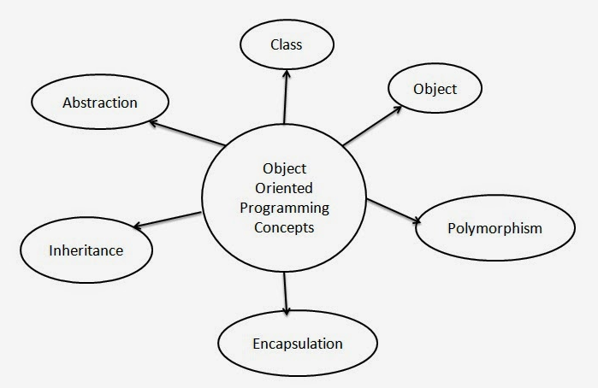
Revision of Object Oriented Programming Concepts
We discuss each of these

Slide 18
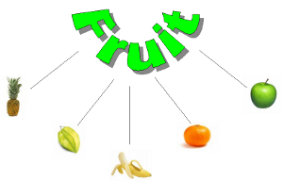
What is a Class and object? A class is the blueprint/template from which individual objects are created. Object is an instance of a Class
Revision of Object Oriented Concepts

Slide 19
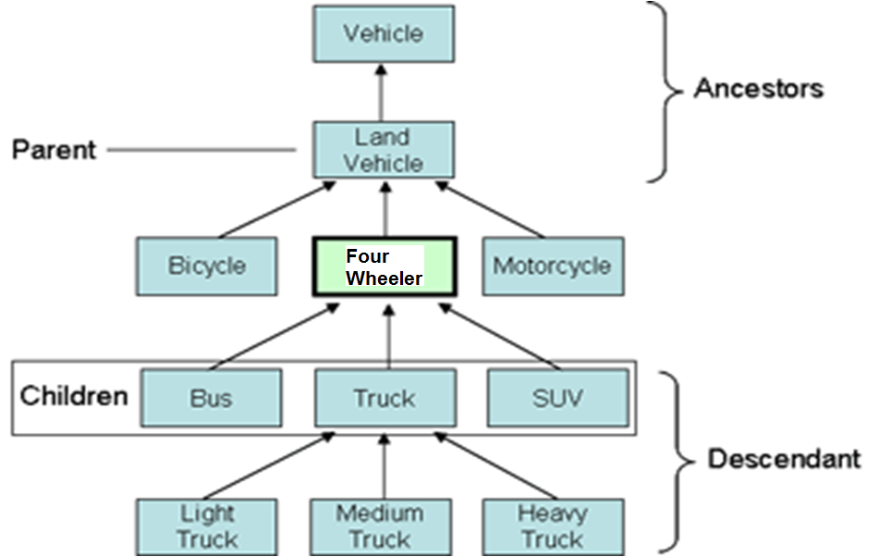
Revision of Object Oriented Concepts
Inheritance: Hierarchical classification, abstraction
Bird
Flying Bird NonFlying Bird
Robin Swallow Penguin Kiwi

Slide 20
Revision of Object Oriented Concepts
Polymorphism
Shape
draw()
Circle
draw()
Box
draw()
Triangle
draw()

Slide 21
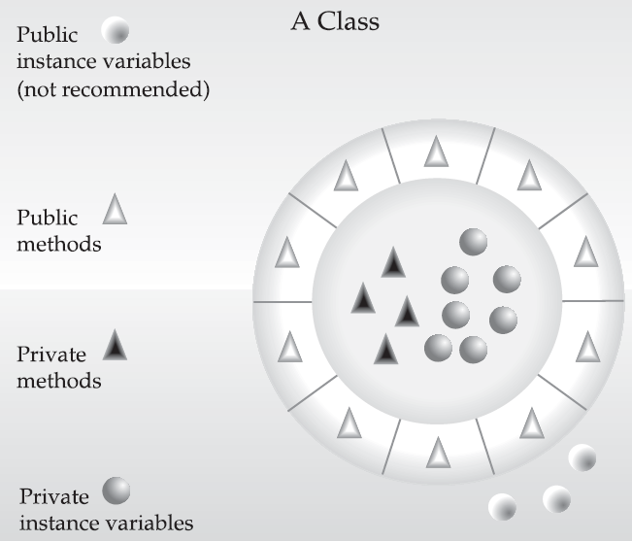
Revision of Object Oriented Concepts
Data Encapsulation: Hiding internal state and allowing controlled interaction to be performed through an object's methods is known as data encapsulation

Slide 22
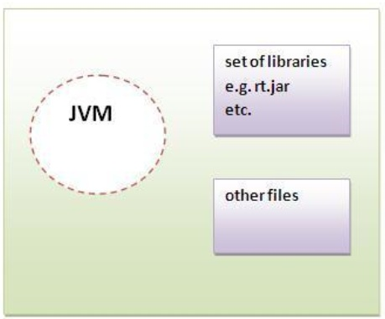
Java Runtime Environment (JRE)
JRE provides environment to run applets and applications written in the Java programming language the
Java Virtual Machine
Set of libraries and
other components

Slide 23
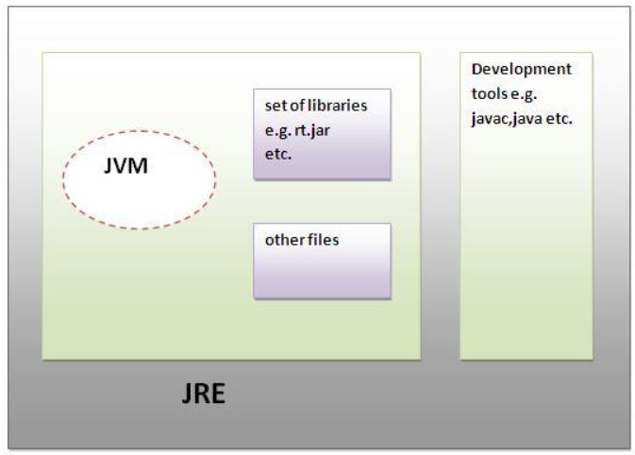
Java Development Kit (JDK)
The JDK is a superset of the JRE, and contains
JRE, plus
tools such as the compilers and debuggers necessary for developing applets and applications

Slide 24
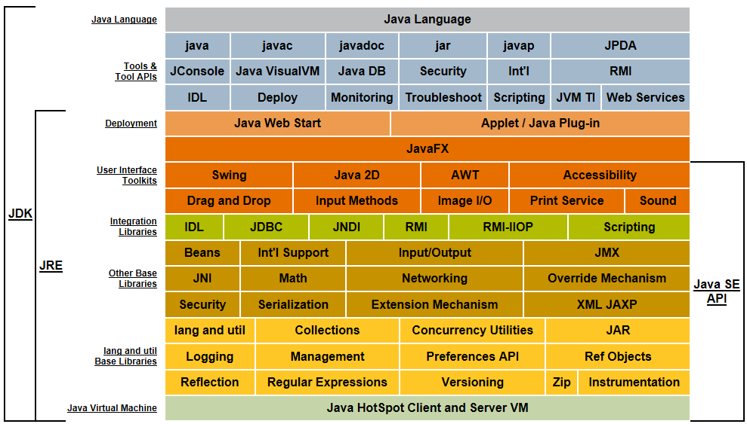

Slide 25
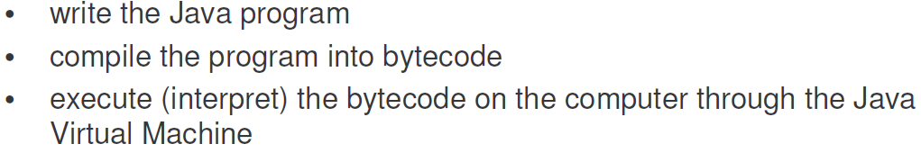

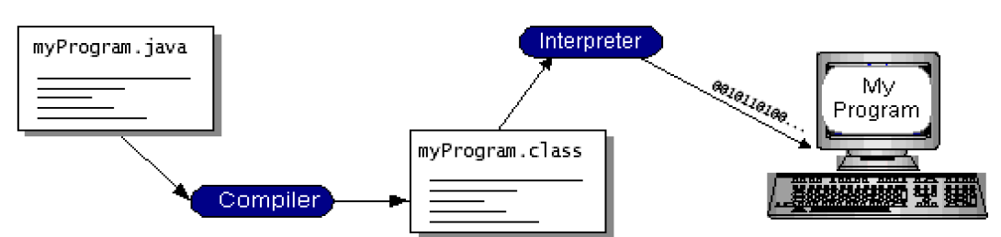

Slide 26
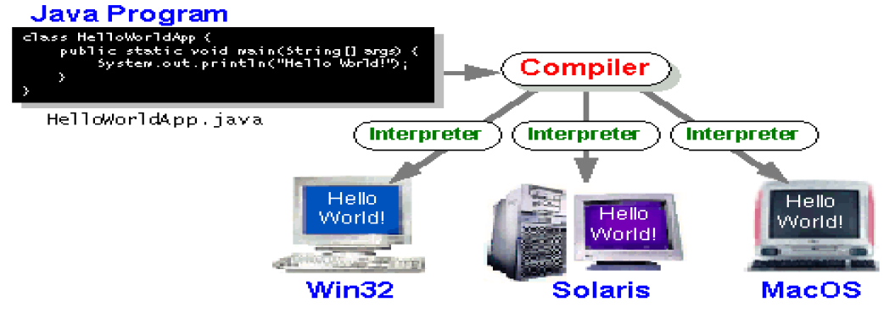

Slide 27

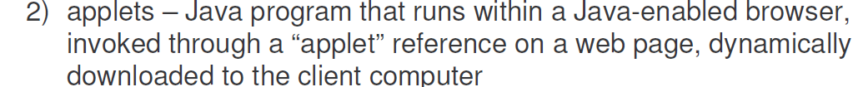

Now discontinued since Java 9

Slide 28



Slide 29
Getting Started: (1)
(1) Create the source file:
open a text editor, type in the code which defines a class (HelloWorldApp) and then save it in a file (HelloWorldApp.java)
file and class name are case sensitive and must be matched exactly (except the .java part)
Example Code: HelloWorldApp.java
/* displays "Hello World!" to the standard output
*/
public class HelloWorldApp
{
public static void main(String[] args)
{
// Display "Hello World!"
System.out.println("Hello World!");
}
}
Java is CASE SENSITIVE!

Slide 30
Getting Started: (2)
(2) Compile the program:
compile HelloWorldApp.java by using the following command:
javac HelloWorldApp.java
it generates a file named HelloWorldApp.class
‘javac’ is not recognized as an internal or external command, operable program or hatch file.
javac: Command not found
if you see one of these errors, you have two choices:
1) specify the full path in which the javac program locates every time. For example:
C:\Program Files\Java\jdk1.7.0_10\bin\javac HelloWorldAp
2) set the PATH environment variable

Slide 31
Getting Started: (3)
(3) Run the program:
run the code through:
java HelloWorldApp
Note that the command is java, not javac, and you refer to
HelloWorldApp, not HelloWorldApp.java or HelloWorldApp.class
Exception in thread "main" java.lang.NoClassDefFoundError:
HelloWorldApp
if you see this error, you may need to set the environment variable CLASSPATH.

Slide 32
Understanding the Program
/** COMMENTS /* */ OR //
* The HelloWorldApp class implements an application
* that displays "Hello World!" to the standard output
*/
public class HelloWorldApp
{
public static void main( String[] args) {
// Display "Hello World!"
System.out.println("Hello World!");
}
} //out - PrintStream

Slide 33
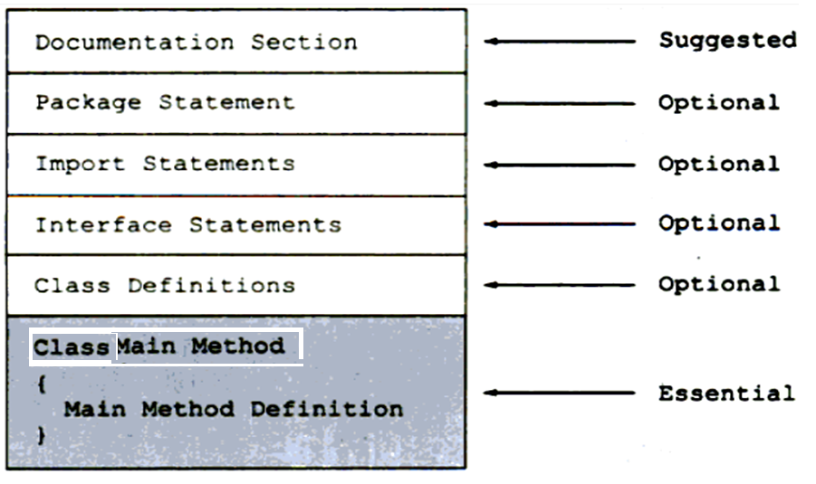
Java Program Structure

Slide 34

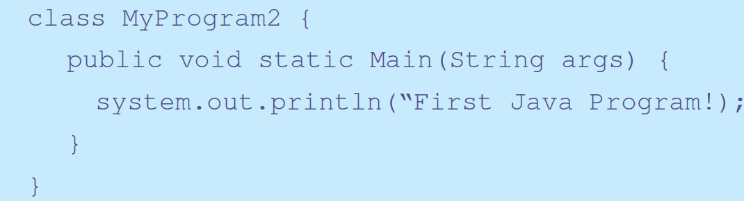
Identify the errors

Slide 35
Java Application Programming Interface is the set of classes included with the Java Development Environment
Java Libraries
Group of classes: Package
Classes, methods, interfaces etc are detailed in Java API Documentation
Available from Oracle’s website
We will now understand more about the JavaAPIDoc

Slide 36
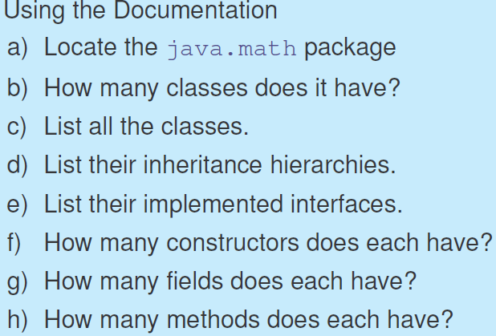
Exercise

Slide 37

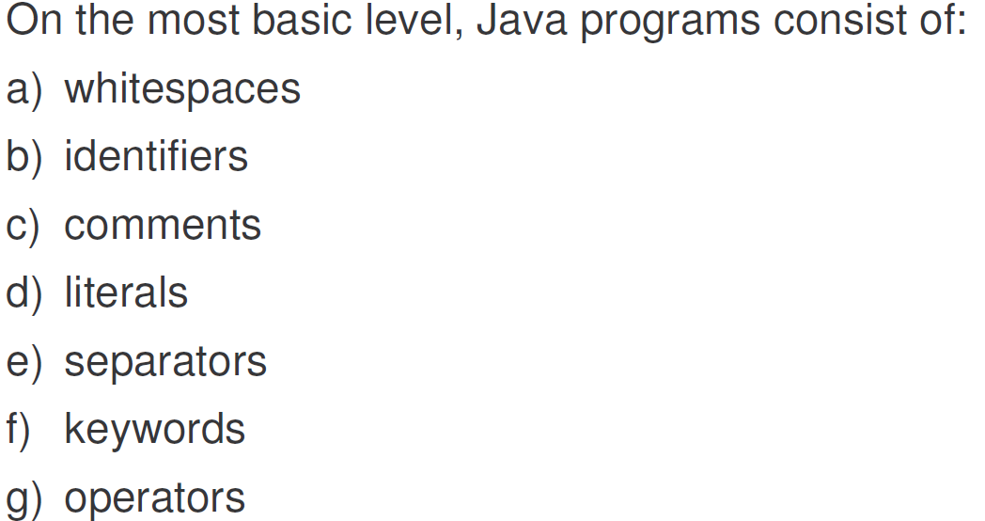

Slide 38

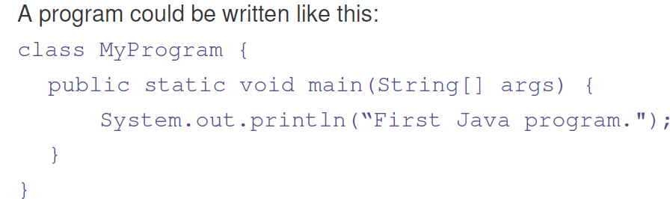
OR Could be written as

Slide 39

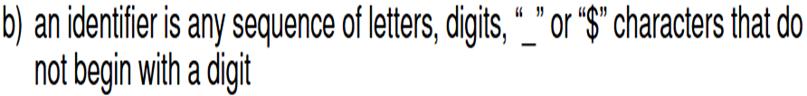
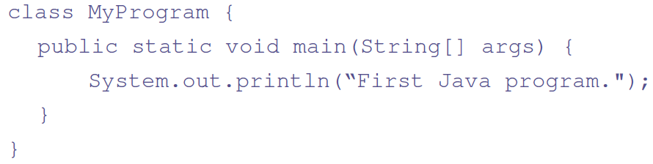
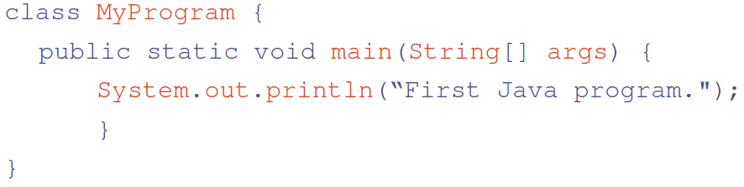
_data1, $val1; //Valid
1data; //Invalid
Find Identifiers in the following program

Slide 40

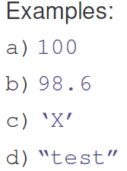
Where do we use them??
if (i==100)
System.out.println(“HUNDRED”);
e) true
f) false
while (ch==‘X’)
System.out.println(“X”);
if (amount==98.6)
balance=0.0;

Slide 41

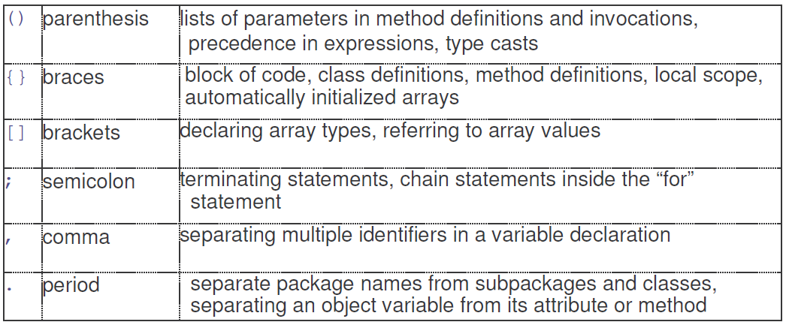

Slide 42

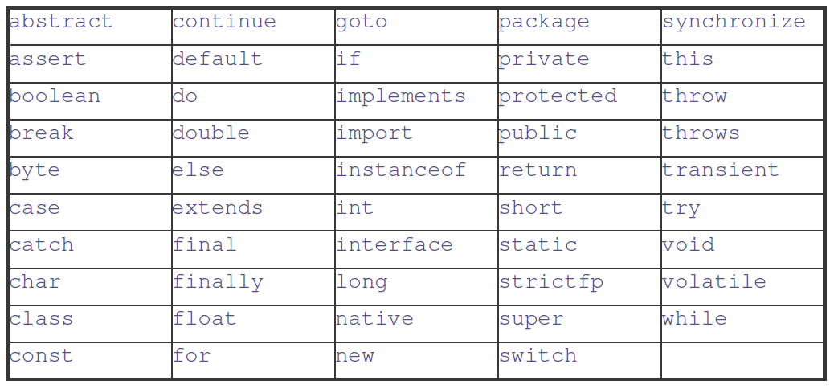
enum

Slide 43

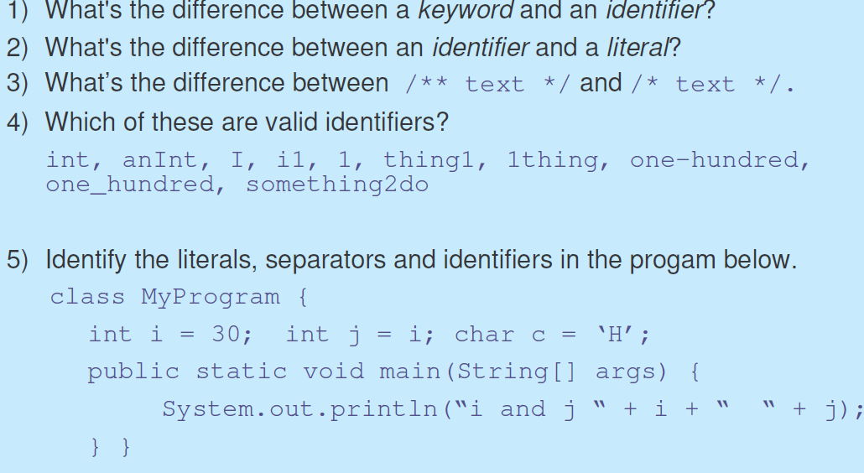

Slide 44


e.g. int data; boolean t=true; //VALID
data; t; //INVALID WHY?
double d=23.5 ; int i=0;
i=d; //INVALID
However i=(int) d; //VALID

Slide 45
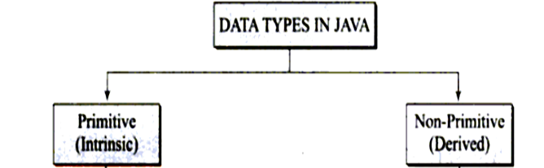
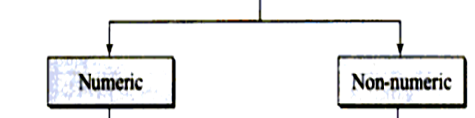
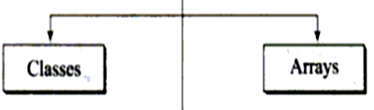
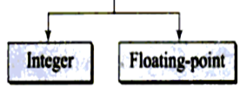
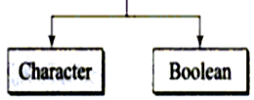

Data Types
byte
short
int
long
float
double
char
boolean

Slide 46






Primitive data types
Integer
Floating point
(Unicode)
size is not precisely defined.
Non Numeric

Slide 47




Though “-15” is int, If value < -128 then compile error. i.e.lower capacity of byte
Two bytes integer type
If value >32767 then compile error
FOUR bytes integer type
If value >2147483647 then compile error

Slide 48



Eight bytes integer type
Four bytes floating type
float f=10.5f; OR float f=10.5F;
Eight bytes floating type

Slide 49


Note :
Even though is 2 bytes stores only one char.
Follows 16-bit Unicode Transformation Format (UTF-16)
In the formal specification of Java, char is defined as Integral data type. However, as its use is to store Unicode, commonly considered as separate type
true and false are literals and cannot be used as identifiers
size is not precisely defined.
Next we see some of the programming examples…..

Slide 50
//Program to Demonstrate Boolean
class BoolTest {
public static void main(String args[ ])
{
boolean b;
b = false;//Initialize
System.out.println("b is " + b); //
b = true;
System.out.println("b is " + b); //
if (b)
System.out.println("executed");
b = false;
if (b)
System.out.println(“not executed");
System.out.println("10 > 9 is " + (10 > 9));
}
}
b is false
b is true

Slide 51
// Demonstrate char data type and String.
class CharDemo
{
public static void main(String args[])
{
char ch1, ch2;
ch2 = 'Y';
ch1 = 'X';
System.out.print("ch1 and ch2: ");
System.out.println(ch1 + " " + ch2);
String s1;
s1="String Demo";
System.out.println("String: "+ s1);
}
} Output : ch1 and ch2:
String: String Demo
X Y

Slide 52
// Write a program to demonstrate the numeric //data types
class NumDemo
{
public static void main(String args[])
{
byte b=126; int i=15;
float f=22.3f; double sum=0.0;
sum=b+i+f;
System.out.println(“Sum is" + sum);
System.out.format("Sum is %.3f%n", sum);
//note %n is newline
}
}
Output : Sum is 163.3000030517578
Sum is 163.300

